Slide 1
Interdependence and the Gains from Trade
CHAPTER 3
Notes:
N. Gregory Mankiw Principles Of Economics Eight Edition

Slide 2
A Parable for the Modern Economy
Only two goods
Meat
Potatoes
Only two people
A cattle rancher named Ruby
A potato farmer named Frank
Both would like to eat both meat and potatoes

Slide 3
A Parable for the Modern Economy, Part 1
If Ruby produces only meat and Frank produces only potatoes
Both gain from trade
If both Ruby and Frank produce both meat and potatoes
Both gain from specialization and trade
Production possibilities frontier
Various mixes of output that an economy can produce

Slide 4
Figure 1 The Production Possibilities Frontier (a)
Empty cell | Minutes needed to make 1 ounce of meat | Minutes needed to make 1 ounce of potatoes | Amount of meat produced in 8 hours | Amount of potatoes produced in 8 hours
Frank the farmer | 60 minutes per ounce | 15 minutes per ounce | 8 ounces | 32 ounces
Ruby the rancher | 20 minutes per ounce | 10 minutes per ounce | 24 ounces | 48 ounces
Panel (a) shows the production opportunities available to Frank the farmer and Ruby the rancher.

Slide 5
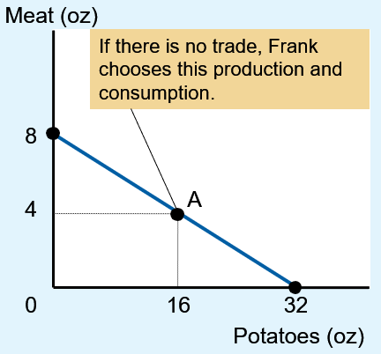
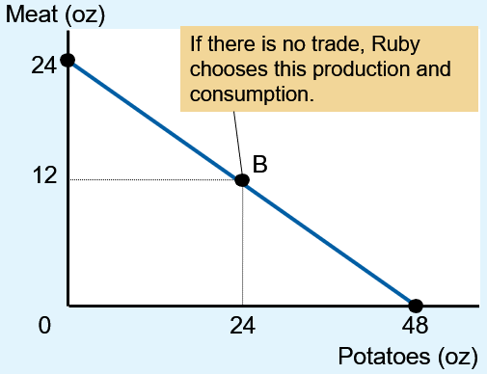
Figure 1 The Production Possibilities Frontier (b, c)
(b) Frank’s production
possibilities frontier
(c) Ruby’s production
possibilities frontier
Panel (b) shows the combinations of meat and potatoes that Frank can produce.
Panel (c) shows the combinations of meat and potatoes that Ruby can produce.
Both production possibilities frontiers are derived assuming that Frank and Ruby each work 8 hours per day. If there is no trade, each person’s production possibilities frontier is also his or her consumption possibilities frontier.

Slide 6
A Parable for the Modern Economy, Part 2
Specialization and trade
Farmer Frank specializes in growing potatoes
More time growing potatoes
Less time raising cattle
Rancher Ruby specializes in raising cattle
More time raising cattle
Less time growing potatoes
Trade: 5 oz of meat for 15 oz of potatoes

Slide 7
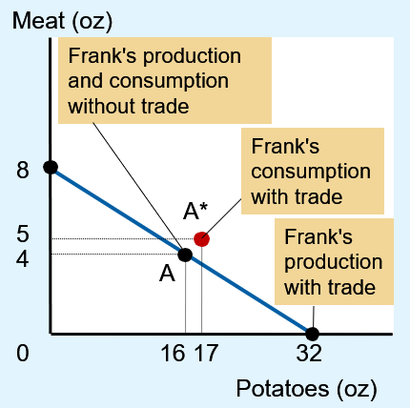
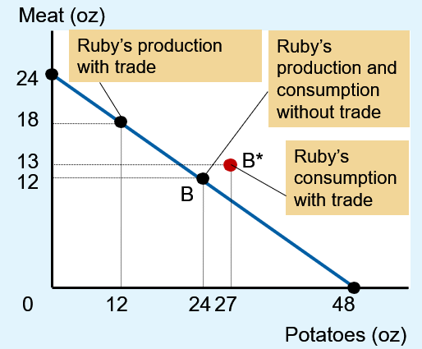
Figure 2 How Trade Expands the Set of Consumption Opportunities (a,b)
(a) Frank’s production
and consumption
(b) Ruby’s production
and consumption
The proposed trade between Frank the farmer and Ruby the rancher offers each of them a combination of meat and potatoes that would be impossible in the absence of trade.
In panel (a), Frank gets to consume at point A* rather than point A.
In panel (b), Ruby gets to consume at point B* rather than point B. Trade allows each to consume more meat and more potatoes.

Slide 8
Figure 2 How Trade Expands the Set of Consumption Opportunities (c)
Empty cell | Frank’s meat | Frank’s potatoes | Ruby’s meat | Ruby’s potatoes
Production and consumption without trade | 4 ounces | 16 ounces | 12 ounces | 24 ounces
Production with trade | 0 ounce | 32 ounces | 18 ounces | 12 ounces
Trade | Gets 5 ounces | Gives 15 ounces | Gives 5 ounces | Gets 15 ounces
Consumption with trade | 5 ounces | 17 ounces | 13 ounces | 27 ounces
Increase in consumption with gains from trade | Increase of 1 ounce | Increase of 1 ounce | Increase of 1 ounce | Increase of 3 ounces

Slide 9
Comparative Advantage, Part 1
Absolute advantage
The ability to produce a good using fewer inputs than another producer
In producing meat: Ruby
Ruby needs 20 min. to produce 1 oz of meat
Frank needs 60 minutes
In producing potatoes: Ruby
Ruby needs 10 min. to produce 1 oz of potatoes
Frank needs 15 minutes

Slide 10
Comparative Advantage, Part 2
Opportunity cost
Whatever must be given up to obtain some item
Measures the trade-off between the two goods that each producer faces

Slide 11
Comparative Advantage, Part 3
Opportunity cost
Frank: 60 min. to produce 1 oz meat, and 15 min. to produce 1 oz potatoes
To produce 1 more oz meat, give up 4 oz potatoes
To produce 1 more oz potatoes, give up ¼ oz meat
Ruby: 20 min. to produce 1 oz meat, and 10 min. to produce 1 oz potatoes
To produce 1 more oz meat, give up 2 oz potatoes
To produce 1 more oz potatoes, give up ½ oz meat

Slide 12
Table 1 The Opportunity Cost of Meat and Potatoes
Empty cell | Opportunity cost of 1 ounce of meat | Opportunity cost of 1 ounce of potatoes
Frank the farmer | 4 ounces of potatoes | One-quarter ounce of meat
Ruby the rancher | 2 ounces of potatoes | One-half ounce of meat

Slide 13
Comparative Advantage, Part 4
Comparative advantage
The ability to produce a good at a lower opportunity cost than another producer
Reflects the relative opportunity cost
Principle of comparative advantage
Each good should be produced by the individual that has the smaller opportunity cost of producing that good
Specialize according to comparative advantage

Slide 14
Comparative Advantage, Part 5
One person
Can have absolute advantage in both goods
Cannot have comparative advantage in both goods
For different opportunity costs
One person has comparative advantage in one good
The other person has comparative advantage in the other good

Slide 15
Comparative Advantage, Part 6
Opportunity cost of one good
Inverse of the opportunity cost of the other
Gains from specialization and trade
Based on comparative advantage
Total production in economy rises
Increase in the size of the economic pie
Everyone is better off

Slide 16
Comparative Advantage, Part 7
Trade can benefit everyone in society
Allows people to specialize in activities in which they have a comparative advantage
The price of trade
Must lie between the two opportunity costs
The principle of comparative advantage explains:
Interdependence
Gains from trade

Slide 17
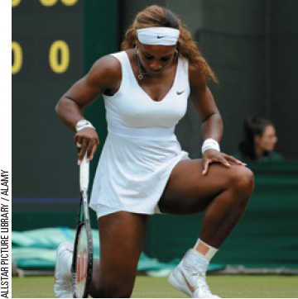
Applications of Comparative Advantage
Should Serena Williams Mow Her Own Lawn?
Serena, in 2 hours
Mow her lawn, or
Film a TV commercial, earn $30,000
Forest Gump, in 4 hours
Mow Serena’s lawn
Work at McDonald’s, earn $50
“They did a nice job with this grass.”

Slide 18
Applications of Comparative Advantage, Part 1
Should the U.S. trade with other countries?
Imports
Goods produced abroad and sold domestically
Exports
Goods produced domestically and sold abroad

Slide 19
Applications of Comparative Advantage, Part 2
Should the U.S. trade with other countries?
U.S and Japan
Each produces food and cars
One American worker, in one month, can produce
One car or 2 tons of food
One Japanese worker, in one month, can produce
One car or 1 ton of food

Slide 20
Applications of Comparative Advantage, Part 3
Principle of comparative advantage
Each good should be produced by the country with the smaller opportunity cost of producing that good
Opportunity cost of a car
Is 2 tons of food in the United States
But only 1 ton of food in Japan
Japan has a comparative advantage in producing cars

Slide 21
Applications of Comparative Advantage, Part 4
Opportunity cost of a ton of food
Is 1 car in Japan
But only ½ car in the United States
The United States has a comparative advantage in producing food
Specialization and trade
All countries have more food and more cars

Slide 22
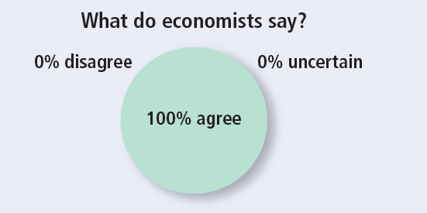
ASK THE EXPERTS, Part 1
Trade between China and the United States
“Trade with China makes most Americans better off because, among other advantages, they can buy goods that are made or assembled more cheaply in China.”

Slide 23
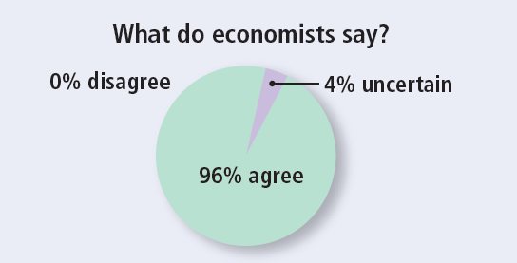
ASK THE EXPERTS, Part 2
Trade between China and the United States
“Some Americans who work in the production of competing goods, such as clothing and furniture, are made worse off by trade with China.”

